Slide 1
E by m experiment by Thomson’s method
N042 Shakambari Kanade

Slide 2
Table of contents
Overview of the experiment
Basic introduction
Electron gun
Vaccum tube or cathode ray tube
Helmholtz coil
Control panel

Slide 3
Overview of the experiment
Discovery of the electron…

Slide 4
Overview of the experiment
During the late nineteenth century JJ Thomson conducted some revolutionary experiments and came up with some crucial observations.
One of his most famous experiment was the cathode ray tube experiment which ultimately led us to the discovery of electrons
Here he found that the value of e by m for these cathode rays remains the same for different cathodes,anodes,gas present and applied voltage.

Slide 5
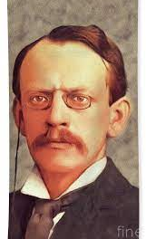
Hence he concluded that cathode rays originating from a heated cathode (electron gun) were actually a stream of small negatively charged particles which he named as “corpuscles”(present day electrons). Thomson won Nobel prize in Physics for discovery of electron in 1906.

Slide 6
Basic introduction
What is the cathode ray tube experiment….

Slide 7
Theory
An electron is deflected in the presence of an electric and magnetic field.
The deflection is dependant on electrons charge ,mass and velocity.
By arranging the electric field and magnetic field perpendicular to each other the deflections due to electric and magnetic fields can nullify each other.
Thus this setup can be used to determine the charge to mass ratio of an electron.
The standard value of e by m ratio is
-1.76*10^11 c*kg^-1

Slide 8
Electron gun
The source of focussed and accelerated electron beam…

Slide 9
Electron gun
It contains of a filament , a cathode, a grid and an anode.
If a highly positive potential ie the anode is placed in front of the heated metal,the emitted electrons will be accelerated in form of beam of electrons.
The beam produced is known as the cathode ray.

Slide 10
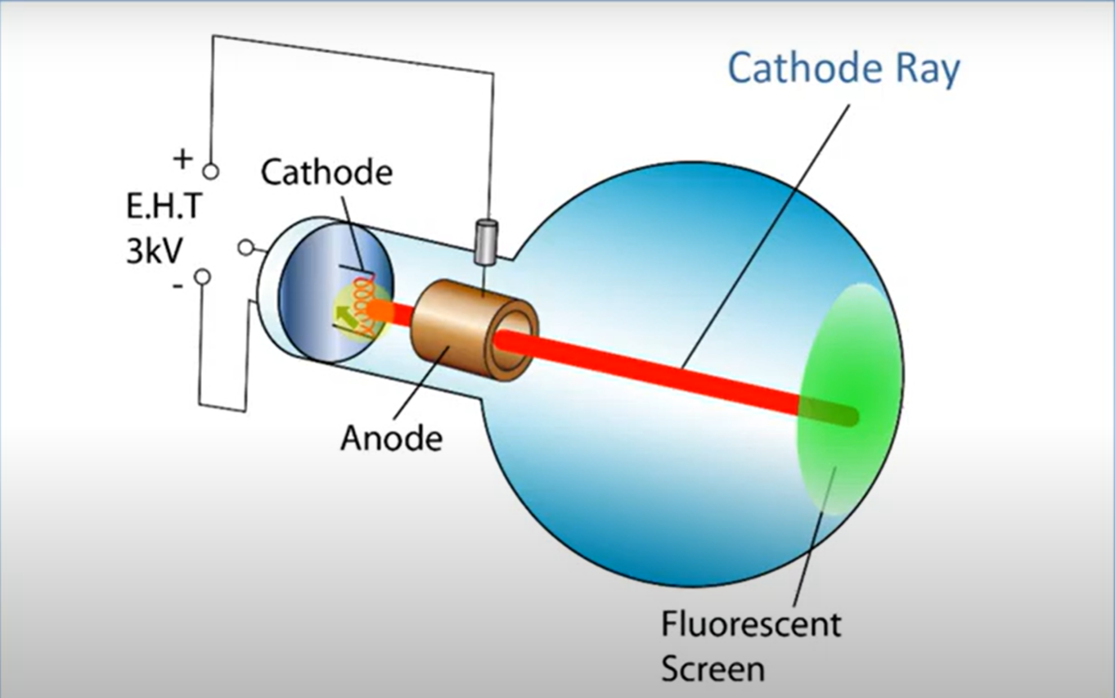
Electron gun

Slide 11
Vaccum tube
Or the cathode ray tube

Slide 12
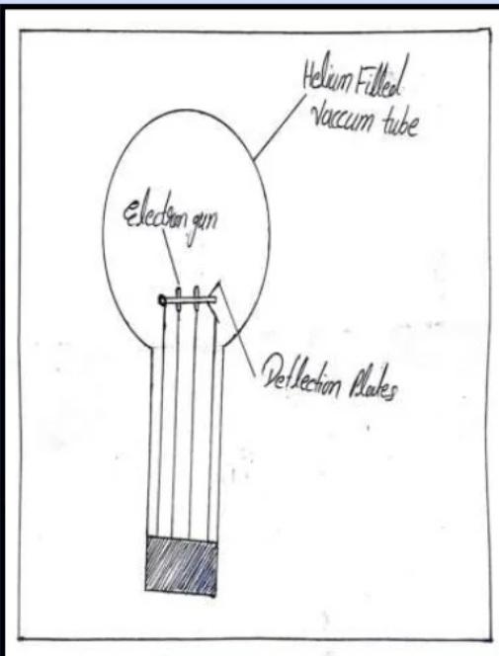
This is a bulb like tube,containing electron gun and deflecting plates.
It is filled with helium gas at very low pressure.
It is placed between a pair of fixed Helmholtz coils.

Slide 13
Some of the electrons emitted by the cathode collide with He atoms which gets excited and radiates visible light
The electron beam thus leaves a visible track in the tube.

Slide 14
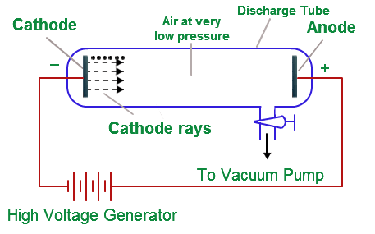
The vaccum conditions in the cathode ray tube are maintained in order to avoid the scattering of cathode rays by gas molecules that would be present in absence of vaccum.
Also the cathode ray tube is always placed along the north south direction.This is so because the magnetic field of the earth is along north south direction.So the motion of electron beam is not affected by earths magnetic field.

Slide 15
Helmholtz coil
Provides the magnetic field

Slide 16
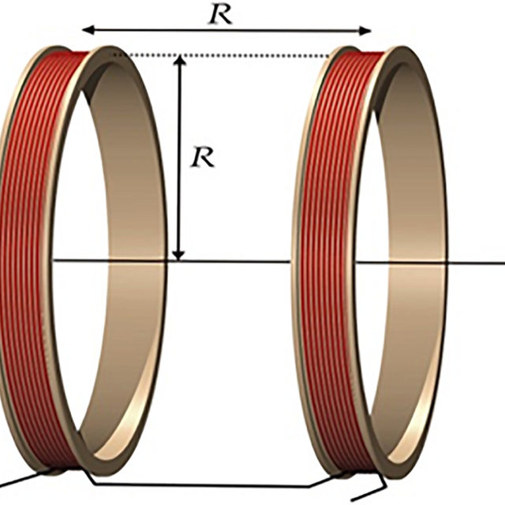
A pair of conducting circular coils each having n turns and each carrying a current I separated by the radius of diastance R equivalent to the radius of circular loops,produce a homogenius magnetic field B in mid plains between the 2 circular coils.

Slide 17
Control panel
Regulation of current and voltage

Slide 18
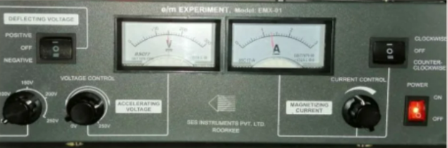
The current to the Helmholtz coil should not be more than 2 amperes.

Slide 19

This Photo by Unknown Author is licensed under CC BY-SA

